Slide 1
Banking Data Analysis in SQL

Slide 2
Table of contents
Database Design & Queries
01
Introduction & Objective
02
03
Results & Insights
04
Conclusion

Slide 3
01
Introduction & Objective

Slide 4
Introduction
Banking data analysis using SQL involves using Structured Query Language to extract, manipulate, and interpret data from banking databases. This process helps in identifying trends, assessing customer behavior, detecting fraudulent activities, and evaluating branch performance to make informed business decisions and enhance operational efficiency.

Slide 5
Objective
To leverage SQL queries for comprehensive banking data analysis, enabling insights into customer behavior, transaction patterns, and branch performance. This includes:
Customer Activation: Identifying inactive customers and strategizing approaches to re-engage them based on regional analysis.
Transaction Insights: Summarizing transaction amounts per account and analyzing daily transaction volumes for trends.
Branch Performance: Ranking branches by deposit performance and identifying branches with the highest average account balances.
Fraud Detection: Detecting suspicious transaction patterns, such as frequent transactions in a single day, and proposing methods to verify potential fraud.
Customer Insights: Determining high-value customers based on deposit amounts and analyzing total transaction volumes by age group.
Operational Metrics: Calculating average transactions per customer and average balances per customer to assess account activity and engagement.

Slide 6
02
Database Design & Queries

Slide 7
List of Datasets
Employees
Branch
Transactions
Accounts
Customers

Slide 8
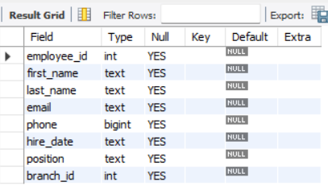

Employees Table
Query:

Slide 9
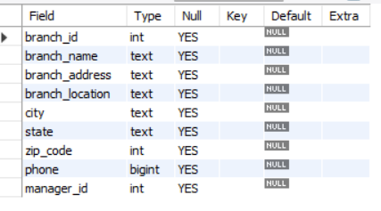

Branch Table
Query:

Slide 10
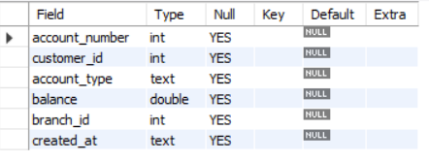
Accounts Table
Query:

Slide 11
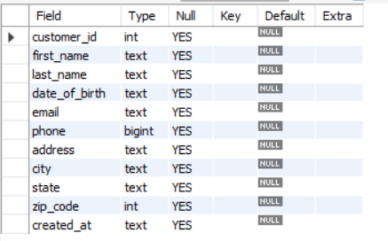

Customers Table
Query:

Slide 12
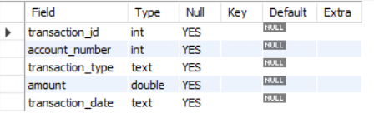
Transactions Table
Query:

Slide 13
03
Results & Insights

Slide 14
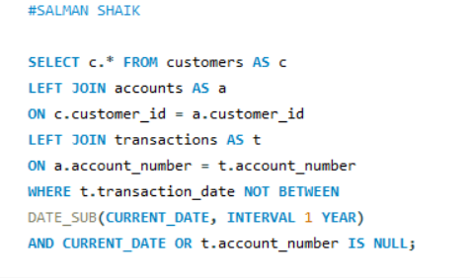
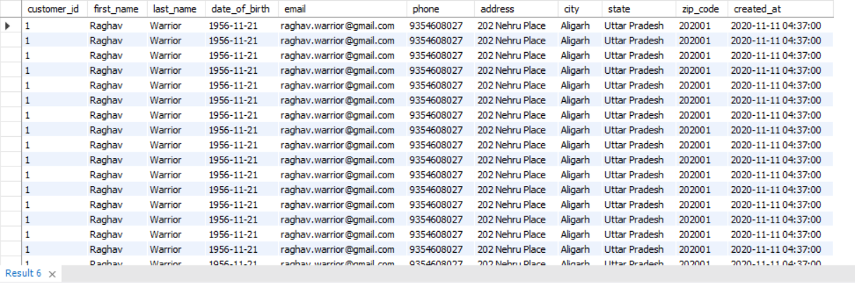
1
Query to list all customers who haven't made any transactions in the last year
Query:
Output:

Slide 15
Making Them Active Again:
Targeted Campaigns: Send personalized offers or reminders based on their region and preferences.
Incentives: Provide discounts, rewards, or cashback on transactions.
Customer Engagement: Reach out through emails, messages, or calls to understand their inactivity.
Enhanced Services: Offer region-specific benefits such as localized branches, support, or exclusive products.

Slide 16
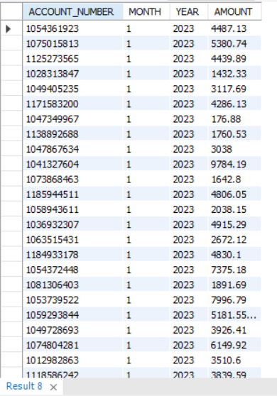
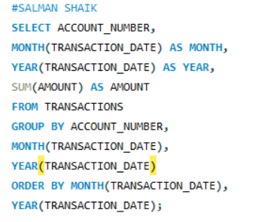
2
Summarize the total transaction amount per account per month.
Query:
Output:

Slide 17
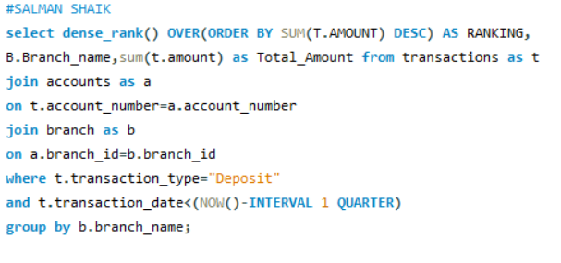
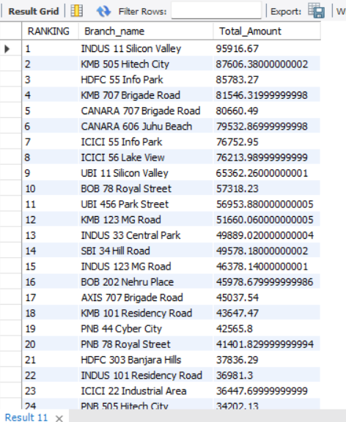
3
Rank branches based on the total amount of deposits made in the last quarter.
Query:
Output:

Slide 18
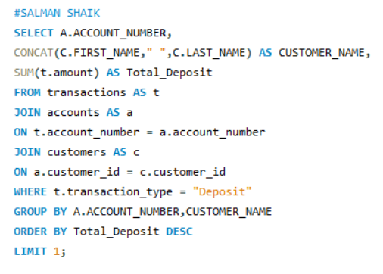

4
Find the name of the customer who has deposited the highest amount.
Query:
Output:

Slide 19
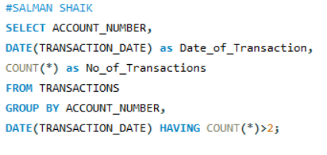
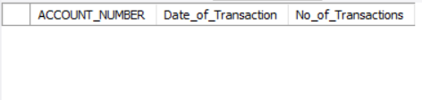
5
Identify any accounts that have made more than two transactions in a single day, which could indicate fraudulent activity. How can you verify any fraudulent transaction?
Query:
Output:

Slide 20
Verifying Fraudulent Transactions:
Analyze Transaction Details:
Check the transaction amounts for unusual patterns (e.g., very high or identical amounts).
Look for repeated transactions within a short time span.
Cross-Check Customer Behavior:
Compare current transactions with the customer’s historical activity.
Look for deviations, such as increased frequency or unusual locations.
Verify Geolocation:
Use geotags from transactions to check if multiple transactions originated from distant or unexpected locations.
Communicate with the Customer:
Notify the account holder to confirm if the transactions were authorized.
Banking Rules and Flags:
Apply rules like thresholds for daily transaction limits.
Review flagged transactions using fraud detection systems.
Fraud Detection Tools:
Leverage machine learning algorithms to detect anomalies in transaction behavior.
Integrate fraud scoring systems for real-time detection.

Slide 21
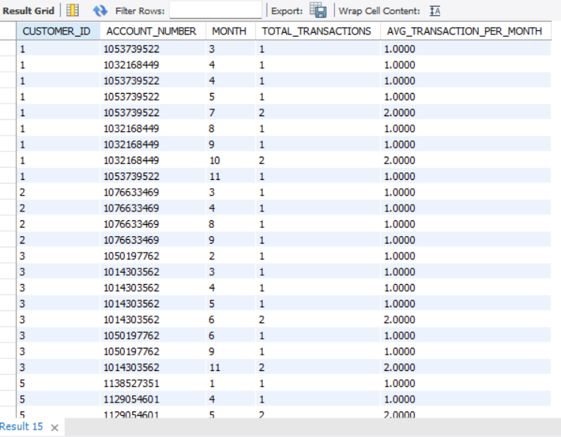
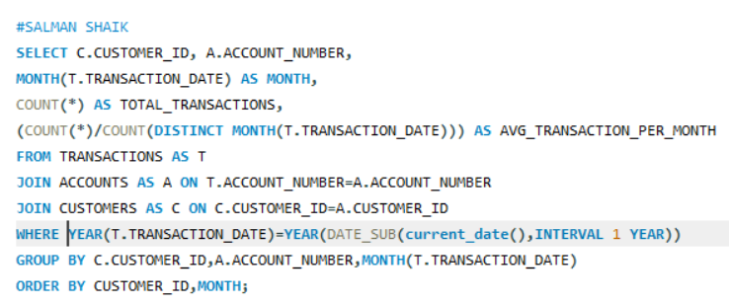
6
Calculate the average number of transactions per customer per account per month over the last year.
Output:
Query:

Slide 22
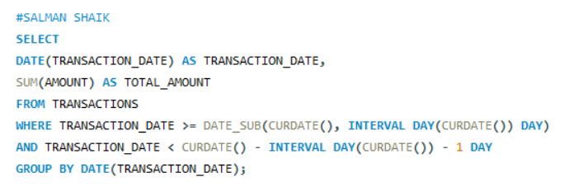

7
Query to find the daily transaction volume (total amount of all transactions) for the past month.
Query:
Output:

Slide 23
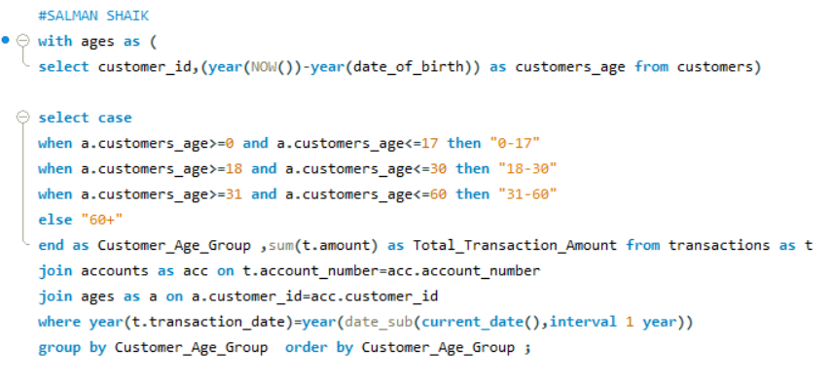
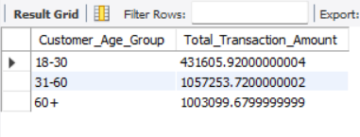
8
Calculate the total transaction amount performed by each age group in the past year. (Age groups: 0-17, 18-30, 31-60, 60+)
Query:
Output:

Slide 24
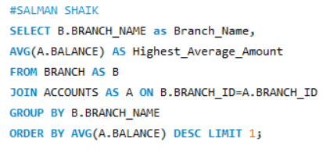
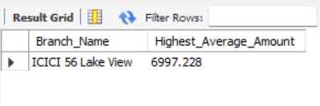
9
Find the branch with the highest average account balance.
Output:
Query:

Slide 25
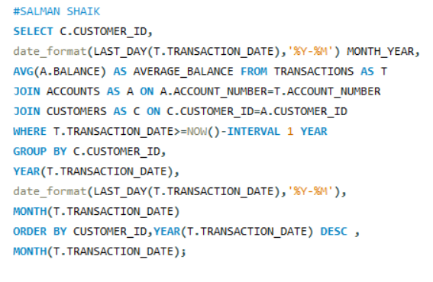
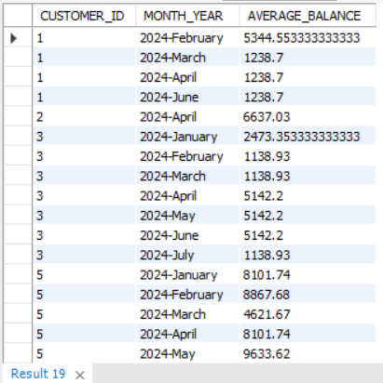
10
Calculate the average balance per customer at the end of each month in the last year.
Query:
Output:

Slide 26
04
Conclusion
Using SQL to identify accounts with unusually high daily transactions helps detect potential fraud. Verification involves analyzing transaction patterns, customer behavior, and leveraging fraud detection tools, ensuring security and building customer trust.

Slide 27
Thanks!
Any questions?
myselfsalman28@gmail.com

